Slide 1
Course Details
Course Code : CSE3003
Course Name: Mobile Application Development [MAD] Credit Structure: 3 Credits (L=1, P=4, C=3)
Instructor In-Charge:

Slide 2
Module 2
User Interfaces, Intent and Fragments

Slide 3
Introduction to Activity
What is Activity?
An Activity is an application component that allows a user to perform an operation.
Eg. Making call, capturing photos and sending messages etc.
An Application is an colection of activities
Main activity provides interface to the user and further invokes the other activity

Slide 4
Creating an Activity
You can create an activity by creating a java class that extends the Activity class.
Each activity needs to create a window in which its user interface components can be loaded.
setContentView(View) method is inoked
onCreate method is called when Activity class is first created.

Slide 5
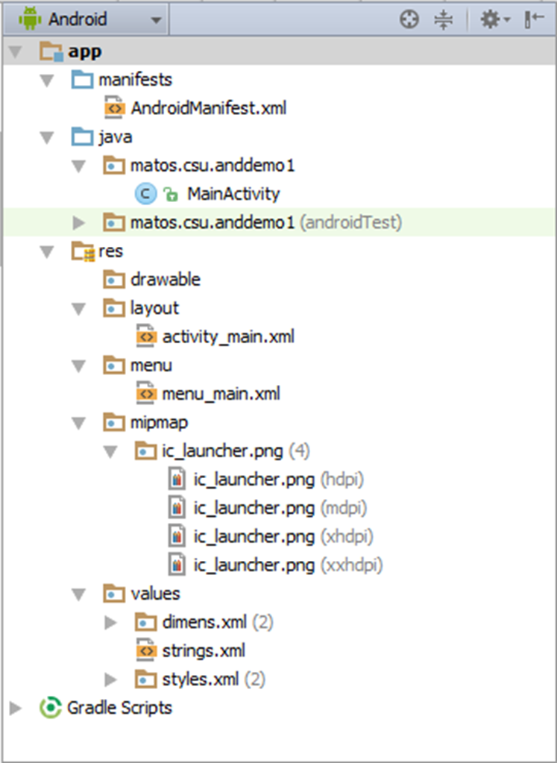
Structure of a typical Android Application (Android Studio)

Slide 6
View, View Groups and Layouts
A layout defines the structure for a user interface in your app, such as in an activity.
All elements in the layout are built using a hierarchy of View and View Group objects.
A View usually draws something the user can see and interact with.
Whereas a View Group is an invisible container that defines the layout structure for View and other View Group objects.
The View objects are usually called "widgets" and can be one of many subclasses, such as Button or TextView.
The ViewGroup objects are usually called "layouts" can be one of many types that provide a different layout structure, such as LinearLayout or ConstraintLayout .

Slide 7
View, View Groups and Layouts
You can declare a layout in two ways:
Declare UI elements in XML. Android provides a straightforward XML vocabulary that corresponds to the View classes and subclasses, such as those for widgets and layouts. You can also use Android Studio's Layout Editor to build your XML layout using a drag-and-drop interface.
Instantiate layout elements at runtime. Your app can create View and View Group objects (and manipulate their properties) programmatically.

Slide 8
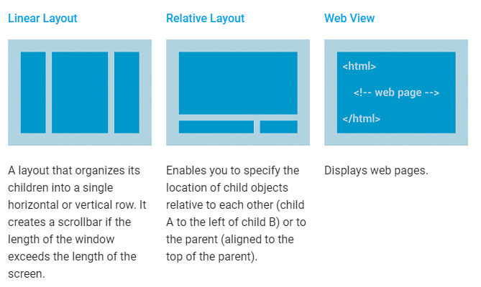
Common Layouts

Slide 9
Linear Layout
Linear Layout is a view group that aligns all children in a single direction, vertically or horizontally. You can specify the layout direction with the android: orientation attribute.
All children of a Linear Layout are stacked one after the other, so a vertical list will only have one child per row, no matter how wide they are, and a horizontal list will only be one row high (the height of the tallest child, plus padding). A Linear Layout respects margins between children and the gravity (right, center, or left alignment) of each child.

Slide 10
Relative Layout
Relative Layout is a view group that displays child views in relative positions. The position of each view can be specified as relative to sibling elements (such as to the left-of or below another view) or in positions relative to the parent Relative Layout area (such as aligned to the bottom, left or center).
A Relative Layout is a very powerful utility for designing a user interface because it can eliminate nested view groups and keep your layout hierarchy flat, which improves performance. If you find yourself using several nested Linear Layout groups, you may be able to replace them with a single Relative Layout.

Slide 11
Constraint Layout
Constraint Layout allows you to create large and complex layouts with a flat view hierarchy (no nested view groups). It's similar to Relative Layout in that all views are laid out according to relationships between sibling views and the parent layout, but it's more flexible than Relative Layout and easier to use with Android Studio's Layout Editor.
All the power of Constraint Layout is available directly from the Layout Editor's visual tools, because the layout API and the Layout Editor were specially built for each other. So you can build your layout with Constraint Layout entirely by drag-and-dropping instead of editing the XML.

Slide 12
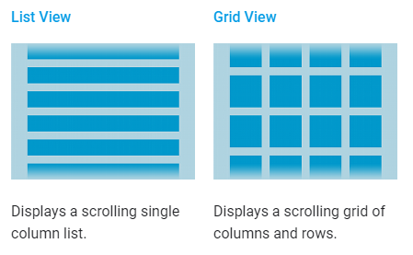
Building Layouts with an Adapter
When the content for your layout is dynamic or not pre-determined, you can use a layout that subclasses Adapter View to populate the layout with views at runtime. A subclass of the Adapter View class uses an Adapter to bind data to its layout.

Slide 13
Recycler View
The Recycler View widget is a more advanced and flexible version of List View.
If your app needs to display a scrolling list of elements based on large data sets (or data that frequently changes), you should use Recycler View.
Several different components work together to display your data.

Slide 14
Intent
An Intent is a messaging object you can use to request an action from another app component.
Although intents facilitate communication between components in several ways,
There are three fundamental use cases:
Starting an activity
Starting a service
Delivering a broadcast

Slide 15
Starting an activity: Cont…
An Activity represents a single screen in an app.
You can start a new instance of an Activity by passing an Intent to startActivity(). The Intent describes the activity to start and carries any necessary data.
If you want to receive a result from the activity when it finishes, call startActivityForResult().
Your activity receives the result as a separate Intent object in your activity's onActivityResult() callback.

Slide 16
Intent Types Cont…
Explicit intents specify which application will satisfy the intent, by supplying either the target app's package name or a fully-qualified component class name. You'll typically use an explicit intent to start a component in your own app, because you know the class name of the activity or service you want to start.
For example, you might start a new activity within your app in response to a user action, or start a service to download a file in the background.
Implicit intents do not name a specific component, but instead declare a general action to perform, which allows a component from another app to handle it.
For example, if you want to show the user a location on a map, you can use an implicit intent to request that another capable app show a specified location on a map.

Slide 17
The two main components of an Intent are:
Action
The built-in action to be performed, such as ACTION_VIEW, ACTION_EDIT, ACTION_CALL, ACTION_SENDTO,... or a user-created-activity
Data
Basic argument needed by the intent to work.
For instance: a phone number to be called , a picture to be shown, a message to be sent, etc.
Activity-1
Activity-2
Intent: { action + data }
Optional results

Slide 18
Components of an Intent : Android Actions
List of common actions that Intents can use for launching built-in activities [usually through startActivity(Intent) ]
ACTION_MAIN ACTION_VIEW ACTION_ATTACH_DATA ACTION_EDIT ACTION_PICK ACTION_CHOOSER ACTION_GET_CONTENT ACTION_DIAL ACTION_CALL ACTION_SEND ACTION_SENDTO | ACTION_ANSWER ACTION_INSERT ACTION_DELETE ACTION_RUN ACTION_SYNC ACTION_PICK_ACTIVITY ACTION_SEARCH ACTION_WEB_SEARCH ACTION_FACTORY_TEST

Slide 19
Components of an Intent : Data
Data Data is supplied as an URI, i.e. a string whose prefix indicates the composition of the data item. For instance:
tel://,
http://,
mailto://,
file://,
content://,
geo:,
audio/,
media/,
vnd.android.cursor.dir

Slide 20
Fragments
A Fragment represents a behavior or a portion of user interface in a FragmentActivity.
You can combine multiple fragments in a single activity to build a multi-pane UI and reuse a fragment in multiple activities.
A fragment must always be hosted in an activity and the fragment's lifecycle is directly affected by the host activity's lifecycle.
you can manipulate each fragment independently, such as add or remove them.
ACTIVITY (Main Host Container)
Fragment1 (View 1)
Fragment3
(View 3)
Fragment2 (View 2)

Slide 21
Fragments
For example, when the activity is paused, so are all fragments in it, and when the activity is destroyed, so are all fragments. However, while an activity is running (it is in the resumed lifecycle state)
When you add a fragment as a part of your activity layout, it lives in a ViewGroup inside the activity's view hierarchy and the fragment defines its own view layout.
You can insert a fragment into your activity layout by declaring the fragment in the activity's layout file, as a <fragment> element, or from your application code by adding it to an existing ViewGroup.

Slide 22
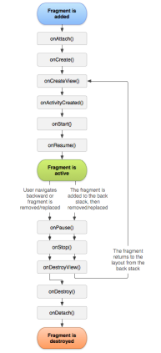
Fragments
Reference: https://developer.android.com/guide/components/fragments

Slide 23
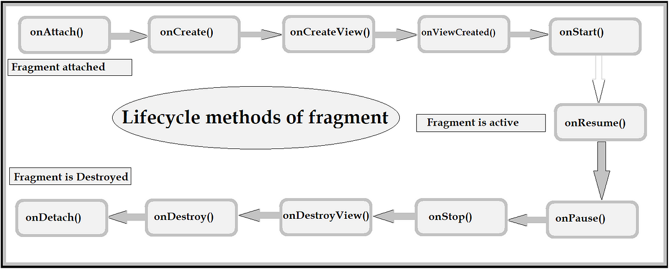
Lifecycle Methods

Slide 24
Fragment’s Lifecycle
onAttach() Invoked when the fragment has been connected to the host activity.
onCreate() Used for initializing non-visual components needed by the fragment.
onCreateView() Most of the work is done here. Called to create the view hierarchy representing the fragment. Usually inflates a layout, defines listeners, and populates the widgets in the inflated layout.

Slide 25
Fragment’s Lifecycle
onPause() The session is about to finish. Here you should commit state data changes that are needed in case the fragment is re-executed.
onDetach() Called when the inactive fragment is disconnected from the activity.

Slide 26
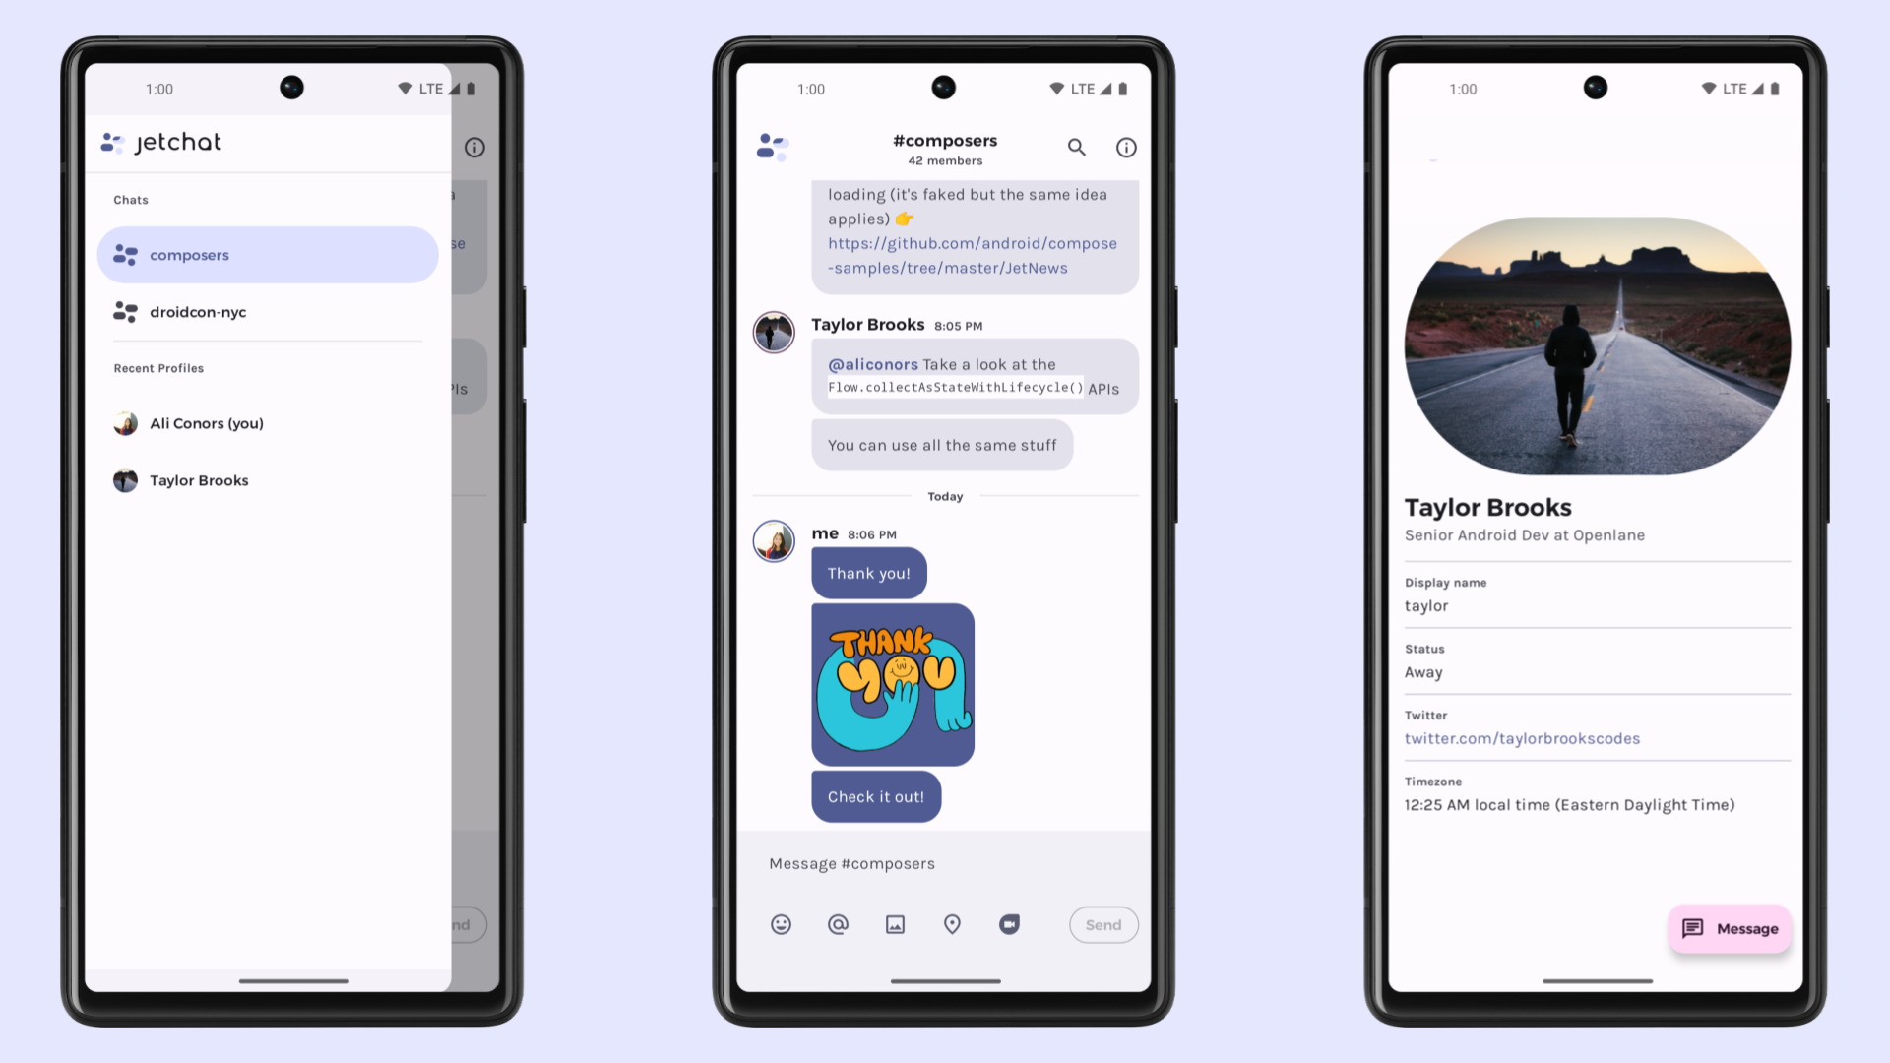
Fragment

Slide 27
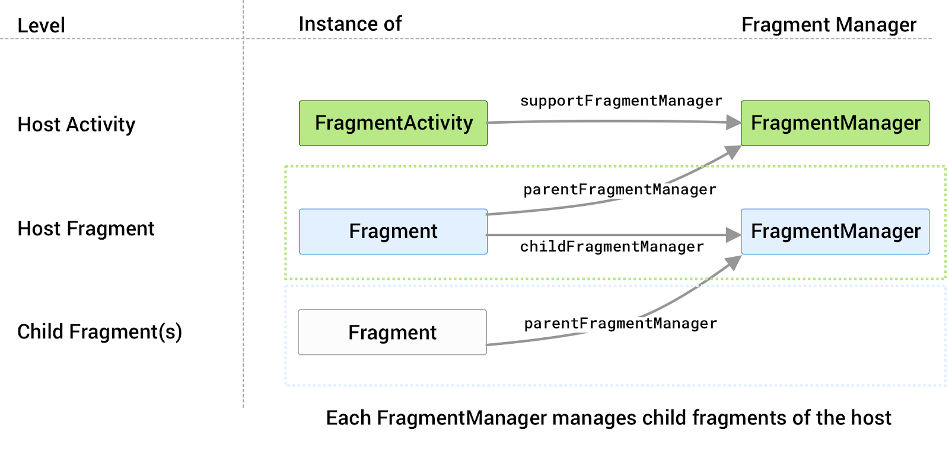
Fragment Manager
A class responsible for performing actions on your app's fragments, such as adding, removing, or replacing them and adding them to the back stack.

Slide 28
Fragment Transactions
At runtime, a FragmentManager can add, remove, replace, and perform other actions with fragments in response to user interaction.
Each set of fragmen.t changes that you commit is called a transaction
FragmentManager fragmentManager = ...
fragmentManager.beginTransaction()
...
.setReorderingAllowed(true)
.commit();

Slide 29
Benefits
Reusability : As here below situation is we need a design having a common header and footer for the different screens and only changeable are is a content area so we can replace all the contents by different fragment.
Adaptiblity & Modularity : adaptive UI according to screen type sizes

Slide 30
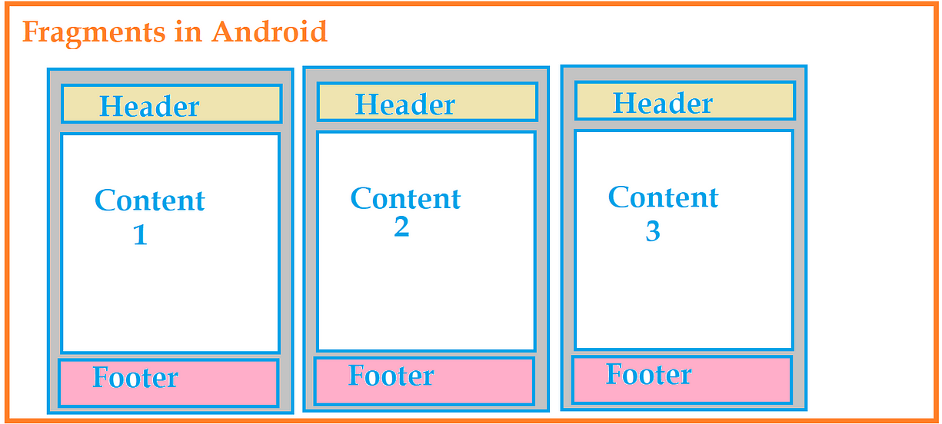
Benefits

Slide 31
END OF MODULE 2

Slide 32
Learn more …
https://developer.android.com/reference/android/view/View
https://www.geeksforgeeks.org/difference-between-view-and-viewgroup-in-android/
https://developer.android.com/develop/ui/views/layout/declaring-layout
https://data-flair.training/blogs/android-layout-and-views/
https://developer.android.com/develop/ui/views/components/menus
https://www.geeksforgeeks.org/android-menus/
https://developer.android.com/guide/components/intents-filters
https://www.geeksforgeeks.org/what-is-intent-in-android/
https://www.geeksforgeeks.org/implicit-and-explicit-intents-in-android-with-examples/
https://developer.android.com/guide/fragments#:~:text=A%20Fragment%20represents%20a%20reusable,an%20activity%20or%20another%20fragment.
https://www.geeksforgeeks.org/fragment-lifecycle-in-android/

Slide 33
Thank You
33
Notes:
33

